Slide 1
Surface Simplification Using Quadric Error Metrics
Brendan Schneider
CAP5726
12/2/20

Slide 2
What’s the Problem?
In graphics, it may become necessary at times to reduce the fidelity of an object or mesh.
Processing speed is highly sought after, so being able to reduce the time it takes to draw or render an image is important.
Perhaps the most obvious example of this would be in gaming, where a player with a less powerful computer should still be able to play by drawing simpler images *that are still recognizable*.

Slide 3
The Solution?
- “Surface Simplification Using Quadric Error Metrics” outlines an algorithm through which we can reduce the number of faces a triangle mesh contains with only minimal sacrifice to the overall shape of the object. This algorithm consists of x steps:
- Find the ‘Q’ matrix for each vertex
- Define pairs of vertices that can be contracted into a single vertex
- Find the “cost” of contracting each pair
- Contract the pair that costs the least, and then recursively repeat this process

Slide 4
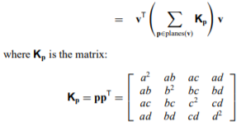
The Q Matrix
- A 4x4 matrix is assigned to each vertex based on the “error quadrics” of the planes (faces) that intersect it.
- This matrix is the error matrix of that vertex and is used to calculate the cost of a pair contraction in step 3.
The error of a vertex v is the sum of all intersecting planes’ error quadrics

Slide 5
Valid Pairs and Costs
- A pair of vertices is considered a valid contraction if it: a) has an edge running between the vertices or b) there is a short distance between the vertices.
- The cost of contracting a pair is based on where it contracts to (usually where the cost is minimized), but the Q matrix of the new vertex will always be equal to the sum of the Q matrices of the pair it contracts from.
- Given that a contraction will go to vertex v-bar, the cost of this contraction is .

Slide 6
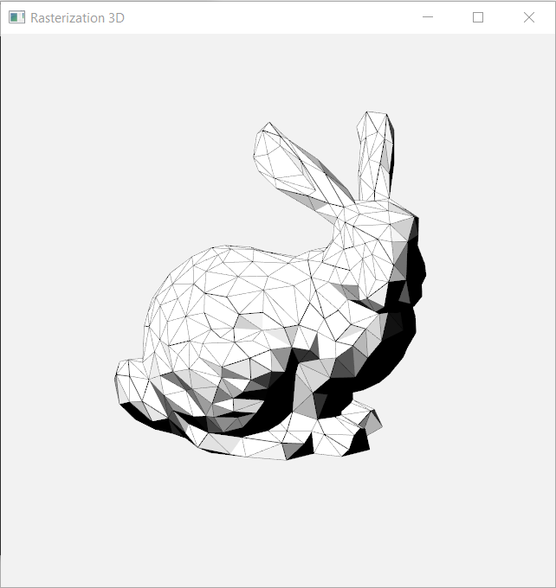

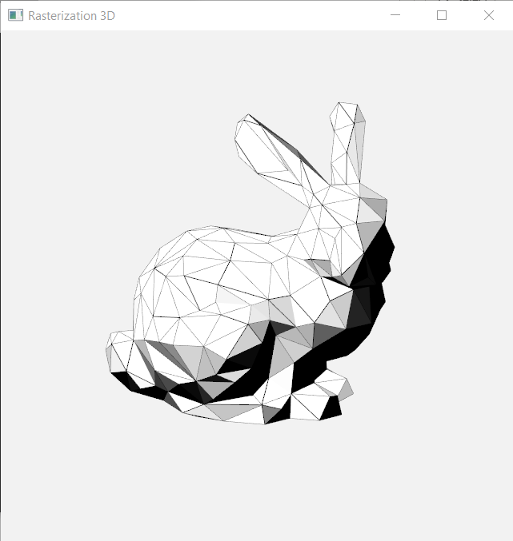
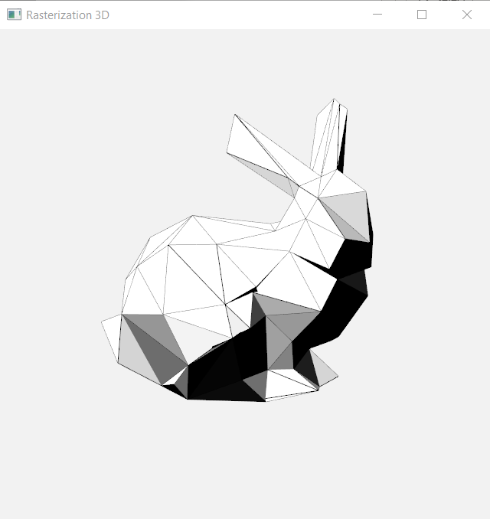
Recursion, Upkeep, and Results
- Now that one vertex has been removed, the program updates all edges and faces that the pair had originally been a part of to instead be a part of the new vertex.
- Costs and Q matrices are updated, and the process can repeat.

